Slide 1
CS 2212
Introduction to Software Engineering
Chapter 20 Software Testing Integration Level

Slide 2
Copyright Notice This Presentation and Its Associated Video Contain Copyright Material. This Presentation and Its Associated Video Are Provided for Teaching Purposes of CS2212 and Should Not Be Posted In Any External Site, Or Shared with. This Presentation and Its Associated Video Are Provided For Instructional Personal Use Only, and Only For The Purposes of the CS2212 Course.

Slide 3
Part 54
Integration Testing
The sooner you start to code, the longer the program will take.
― Roy Carlson.
Notes:
This lesson introduces the basic steps in a software engineering project at a high level.
In practice, steps often overlap.

Slide 4
Learning Objectives in this Part
To learn about integration testing and its strategies

Slide 5
Integration Testing
Objectives:
To expose problems arising from the combination
To quickly obtain a working solution from components.
Problem areas
Internal: between components
Invocation: call/message passing/…
Parameters: type, number, order, value
Invocation return: identity (who?), type, sequence
External:
Interrupts (wrong handler?)
I/O timing
Interaction

Slide 6
Integration Testing
Types of integration
Structural
“Big bang” ⬅ no error localization
Top-down: top, stubs, (stub ⬅ module), early demo
Bottom-up: terminal, driver/module, (driver ⬅ module)
Behavioral

Slide 7
Top Down Integration
In this approach to incremental integration, modules are integrated by moving downward through the control hierarchy, beginning with the main control module (or main program)
Modules subordinate to the main control module are incorporated into the structure in either a depth-first or breadth-first fashion, recursively resulting in the integration of all modules
Because modules are integrated from the top down, drivers (control programs for testing) are not needed, as this functionality is provided by what has already been integrated

Slide 8
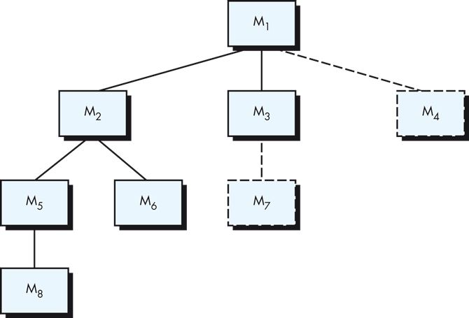
Top Down Integration

Slide 9
Top Down Integration
The integration process is generally performed in a series of five steps:
The main control module is used as a test driver and stubs are substituted for all components directly subordinate to the main control module
Depending on the integration approach selected (depth or breadth first), subordinate stubs are replaced one at a time with actual components
Tests are conducted as each component is integrated
On completion of each set of tests, another stub is replaced with the real component
Regression testing (discussed shortly) may be conducted to ensure that new errors have not been introduced in previously tested code

Slide 10
Bottom Up Integration
In this approach to incremental integration, construction and testing begins with atomic modules (i.e., components at the lowest levels in the program structure)
Because components are integrated from the bottom up, the functionality provided by components subordinate to a given level is always available and the need for stubs is eliminated

Slide 11
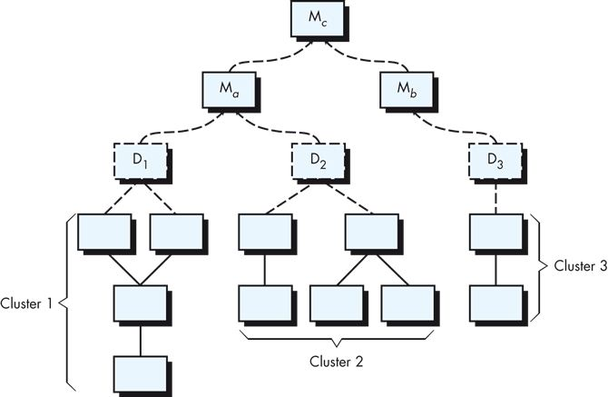
Bottom Up Integration

Slide 12
Bottom Up Integration
A bottom up integration strategy may be implemented as follows:
Low-level components are combined into clusters (sometimes called builds) that perform a specific software subfunction
A driver is written to coordinate test-case input and output
The cluster is tested
Drivers are removed and clusters are combined moving upward in the program structure

Slide 13
Sandwich Testing
Sandwich testing is a hybrid approach to integration, combining both top down and bottom up strategies
Higher levels of the program structure are integrated top down
Lower levels of the program structure are integrated bottom up into clusters
These elements are then integrated together
In taking this hybrid approach, the number of drivers and stubs required for integration can be reduced substantially and the integration process can be greatly simplified

Slide 14
MM-Path Example
1
A
B
1
C
Figure 1
1
4
2
2
2
3
3
4
3
3
4
5
4
5
6
Figure 1 above illustrates an MM-Path (the heavy line) for three modules.
For example, in module A nodes 1 and 5 are source nodes while nodes 4 and 6 are sink nodes.
In module B nodes 1, 3 are source nodes and 2, 4 are sink nodes.
Ref: “Software Testing A Craftsman's Approach” 2nd edition, Paul C. Jorgensen

Slide 15
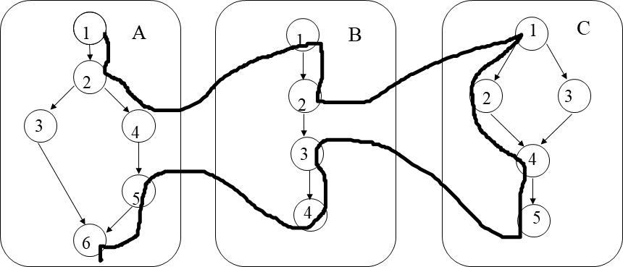
Execution Paths Example
In addition, the following are module execution paths:
MEP(A,1) = <1,2,3,6> MEP(B,1) = <1,2>
MEP(A,2) = <1,2,4> MEP(B,2) = <3,4>
MEP(A,3) = <5,6> MEP(C,1) = <1,2,4,5>
MEP(C,2) = <1,3,4,5>

Slide 16
MM-Path Graph
Given a set of units,
their MM-Path graph is the directed graph in which nodes are module execution paths and,
edges correspond to messages and returns from one unit to another
The definition is with respect to a set of units.
It directly supports composition of units and composition based integration testing.

Slide 17
MM-Path Graph Example
MEP(A,2)
MEP(B,1)
MEP(A,1)
MEP(C,1)
Figure 2
MEP(B,2)
MEP(A,3)
MEP(C,2)
Figure 2 above illustrates the MM-Path graph for the example in Figure 1. The solid arrows indicate messages and the corresponding returns are indicated by dotted arrows.
Ref: “Software Testing A Craftsman's Approach” 4th edition, Paul C. Jorgensen

Slide 18
Integration Testing (Behavioral: Path-Based)
A
B
C
MM-path: Interleaved sequence of module exec path and messages
Module exec path: entry-exit path in the same module
Atomic System Function: port input, … {MM-paths}, … port output
Test cases: exercise ASFs

Slide 19
Part 55
Regression, Functional, and System Testing
Weeks of coding can save you hours of planning.
― Unknown.
Notes:
This lesson introduces the basic steps in a software engineering project at a high level.
In practice, steps often overlap.

Slide 20
Learning Objectives in this Part
To learn about regression, functional, and system testing

Slide 21
Regression Testing
Regression testing is the re-execution of some subset of tests that have already been conducted to ensure that changes have not propagated unintended side effects
Whenever software is corrected, some aspect of the software configuration (the program, its documentation, or the data that support it) is changed
Regression testing helps to ensure that changes (due to testing or for other reasons) do not introduce unintended behavior or additional errors
Regression testing may be conducted manually, by re-executing a subset of all test cases or using automated capture/playback tools

Slide 22
Regression Testing
The regression test suite contains three different classes of test cases:
A representative sample of tests that will exercise all software functions
Additional tests that focus on software functions that are likely to be affected by the change
Tests that focus on the software components that have been changed
As integration proceeds, the number of regression tests can grow quite large; therefore, the regression test suite should be designed to include only those tests that address one or more classes of errors of each of the major program functions

Slide 23
Validation Testing
Validation testing begins at the culmination of integration testing
Individual components have been exercised, the software is completely assembled as a package, and interfacing errors have been uncovered and corrected
Testing now focuses on user visible actions and user recognizable output from the system
Validation succeeds when software functions in a manner that can be reasonably expected by the customer
Software requirements analysis should have already done a good job of determining and specifying what exactly is “reasonably expected by the customer”

Slide 24
Acceptance, Alpha, and Beta Testing
It is virtually impossible for a software developer to foresee how the customer will really use a program
When custom software is built for one customer, a series of acceptance tests are conducted to enabled the customer to validate all requirements
In essence, the customer gets to “test drive” the software for anywhere from a few hours to a period of weeks or months, depending on the software
If software is developed as a product to be used by many customers, it is impractical to perform formal acceptance tests with each one, and so a process of alpha and beta testing is used to uncover errors that only the end user seems able to find

Slide 25
Acceptance, Alpha, and Beta Testing
The alpha test is conducted at the developer’s site by a representative group of end users in a somewhat controlled environment
The beta test is conducted at one or more end-user sites; unlike alpha testing, the developer generally is not present
The beta test is a “live” application of the software in an environment that cannot be controlled by the developer and so represents realistic operating conditions

Slide 26
Acceptance, Alpha, and Beta Testing
Many digital distribution platforms require software to undergo another form of acceptance testing before the software is made available through the platform, with such testing performed by the platform-owner
Such tests are required to ensure a standard of quality from all software and to ensure that requirements of the platform are being adequately addressed by the software in question
This is common for mobile apps (distributed through Apple and Google storefronts) and for game software made for various consoles (for Sony, Nintendo and Microsoft, for example)

Slide 27
System Testing
Software is only one element of a larger computer-based system
Ultimately, the software is incorporated with other system elements (hardware, people, information) and a series of system integration and validation tests are conducted
These tests fall outside the scope of the software process and are not conducted solely by software engineers
That said, steps taken during software design and testing can greatly improve the probability of successful software integration in the larger system

Slide 28
Types of System Testing
Recovery testing
Forces the software to fail in a variety of ways and verifies that recovery is properly performed
Security testing
Verifies that protection mechanisms built into a system will, in fact, protect it from improper penetration
Stress testing
Executes a system in a manner that demands resources in abnormal quantity, frequency, or volume

Slide 29
Types of System Testing
Performance Testing
Tests the run-time performance of software within the context of an integrated system
Deployment Testing
Exercises the software in each environment in which it is to operate, examining all installation procedures and tools that will be used
Sometimes also called configuration testing

Slide 30
Your Turn
What is the difference between a Module Execution Path (MEP) and an MM-Path?
What is a driver and what is a stub component in Integration testing?
What is the difference between Alpha testing and Beta testing?
Show how top-down Integration testing will proceed in the figure of slide 7. Indicate the sequence of modules being integrated in each integration iteration and clearly show the driver components and the stub components in every iteration.
Check-out the content of the following sites:
https://en.wikipedia.org/wiki/Integration_testing
https://martinfowler.com/bliki/IntegrationTest.html
https://www.guru99.com/alpha-testing.html
https://test.io/beta-testing/
https://www.agnosticdev.com/blog-entry/testing/system-testing-and-functional-testing
https://www.geeksforgeeks.org/difference-between-system-testing-and-acceptance-testing/
https://artoftesting.com/difference-between-system-and-integration-testing

